Slide 1
Decision-Focused Probabilistic Forecasting
Aligning Retail Demand Predictions with Inventory Cost Objectives.
Presented by -
ALABYEKKUBO SSUUBI BRIAN
Affiliation: Makerere University, Uganda

Slide 2
Contents of Presentation
Introduction
Problem Statement
Related work
Objectives
Research Questions
Research Contribution
Methodology
Preliminary Results
Next Steps
Conclusion
References

Slide 3
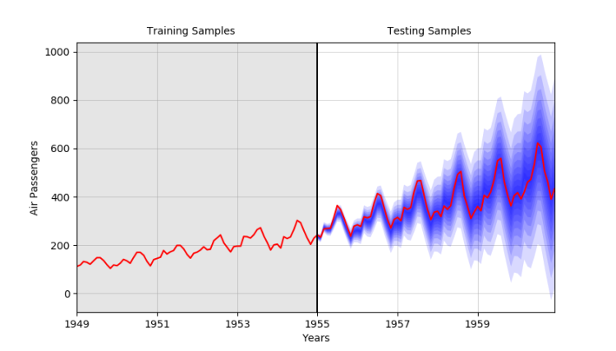
Introduction
Retail demand forecasting is critical for driving inventory decisions, cost efficiency, and service levels.
Traditional forecasting models optimize accuracy metrics (MAE, RMSE) but ignore the actual cost consequences of stockouts and overstock.
Retail demand is uncertain, seasonal, hierarchical, and price-sensitive—requiring probabilistic, not point forecasts.
The M5 Walmart dataset provides a rich, real-world environment for evaluating advanced forecasting systems.
This work develops a decision-focused probabilistic forecasting framework that directly optimizes inventory costs rather than just prediction error.

Slide 4
Introduction cont’d
Despite progress in ML and DL, forecasting models rarely translate predictive accuracy into better operational decisions.
Inventory management requires balancing asymmetric costs:
Stockouts → lost sales, customer dissatisfaction, service failure
Overstock → holding costs, waste, markdown losses
Probabilistic forecasts quantify uncertainty, but without decision-aligned training, we often misrepresent the true risk structure retailers face.
We look to integrate the operational cost function directly into the model, ensuring predictions are optimized for real economic impact.
This research positions decision-focused forecasting as a practical shift from “predicting well” to “deciding optimally under uncertainty.”

Slide 5
Problem Statement
Traditional forecasting systems optimize for statistical accuracy metrics:
MAE, RMSE
These models excel at minimizing prediction error but fail to account for the operational reality of inventory management.
The Core Problem:
Business value in supply chains derives not from forecast accuracy alone, but from the inventory decisions these forecasts inform. Supply chain decisions face asymmetric costs:
  Stockouts incur lost sales, customer dissatisfaction, brand damage
  Overstocking → working capital, increases holding costs, and risks product obsolescence
The Critical Gap:
  A forecast with low statistical error may still lead to suboptimal—even costly—inventory decisions if the model is not aligned with the actual operational objective.
  Current 2 stage approaches (predict-then-optimize) optimize the wrong objective function, leading to a misalignment between forecast quality and decision quality.
The Challenge:
  Can we train forecasting models that directly optimize for downstream operational costs rather than statistical accuracy, while still maintaining probabilistic calibration and forecast coherence across hierarchical product structures?

Slide 6
Related Works
Traditional probabilistic forecasting:
optimizes proper scoring rules to produce well-calibrated predictive distributions. Koenker and Bassett (1978) introduced quantile regression with pinball loss, which has become the standard approach for estimating conditional quantiles.
Gneiting and Raftery (2007) formalized the framework of strictly proper scoring rules, including the Continuous Ranked Probability Score (CRPS), which evaluates the full predictive distribution rather than individual quantiles.
These methods excel at producing statistically calibrated forecasts—ensuring that predicted quantiles match empirical coverage rates—but they do not optimize operational objectives. A model trained on pinball loss minimizes quantile prediction error without considering the asymmetric costs of inventory decisions.
Decision-Focused Learning:
Elmachtoub and Grigas (2022) introduced the "predict-then-optimize" framework, demonstrating that training predictive models to directly minimize downstream decision costs consistently outperforms traditional two-stage approaches where prediction and optimization are decoupled.
  Their smart "predict-then-optimize" method computes gradients through optimization problems, enabling end-to-end learning.
This framework has been applied to
portfolio optimization, energy scheduling, and routing problems.
This work extends decision-focused learning to probabilistic demand forecasting under newsvendor objectives, incorporating contextual service levels and hierarchical product structures unique to retail supply chains.

Slide 7
Related Works (2)
Retail Forecasting and Neural Architectures
The M5 Competition (Makridakis et al., 2022) established rigorous benchmarks for hierarchical retail forecasting, emphasizing both point accuracy and probabilistic calibration across thousands of products. The competition highlighted challenges in handling intermittent demand, promotional effects, and hierarchical aggregation.
Recent neural approaches have advanced retail forecasting capabilities. Salinas et al. (2020) developed DeepAR, an autoregressive recurrent network for probabilistic forecasting that learns across multiple related time series. Lim et al. (2021) introduced Temporal Fusion Transformers (TFT), which combine multi-horizon forecasting with interpretable attention mechanisms, variable selection, and learned embeddings for categorical features.
These architectures provide the representational capacity for decision-focused training. We adapt both gradient-boosted methods (LightGBM) and TFT for newsvendor objectives, comparing their performance under operational cost metrics.

Slide 8
RESEARCH CONTRIBUTION
# | Contribution | Innovation | Impact
1 | Decision-Focused Training with Contextual Service Levels | First framework to integrate learned contextual τ(xt)\tau(x_t) τ(xt​) into newsvendor objectives for retail forecasting | Moves beyond fixed critical ratios to adaptive inventory policies that respond to product heterogeneity, seasonality, and promotions
2 | Unified Forecast-Decision Evaluation Protocol | Couples statistical accuracy (MASE, RMSSE, CRPS) with operational metrics (cost, fill rate, stockouts) in single framework | Enables direct assessment of whether forecast improvements translate to operational value—bridging research and practice
3 | Hierarchical Reconciliation for Decision-Focused Forecasts | Integrates both bottom-up and MinT-style reconciliation into decision-focused pipeline with coherence analysis | Ensures item-level cost optimization remains coherent with department/store/state planning—critical for real supply chains
4 | Comprehensive Ablation Studies | Systematic evaluation across cost ratios (2:1 to 20:1) Architectures (LightGBM, TFT) Product segments Calibration methods | Provides practitioners with decision rules for when to use fixed vs. contextual service levels and which architectures suit their constraints

Slide 9
Objectives and Research Questions
Primary Objective:
Develop a decision-focused probabilistic forecasting framework that directly aligns retail demand predictions with inventory cost objectives, bridging the gap between forecast accuracy and operational performance.
Specific Objectives:
Implement Decision-Focused Training Pipeline
  Design a differentiable newsvendor loss function that minimizes expected holding and shortage costs
  Develop both fixed service level (τ*) and contextual service level (τ(x)) implementations
  Create smooth gradient-flow surrogates for non-differentiable inventory cost functions
Build Unified Evaluation Framework
  Couple traditional forecast quality metrics (MASE, RMSSE, CRPS) with operational decision quality metrics (expected cost, fill rate, stockout frequency)
  Implement rolling-origin validation across 3,049 products over multiple evaluation folds
Ensure Probabilistic Calibration
  Develop calibration assessment protocols (reliability diagrams, coverage tests)
  Implement post-hoc calibration corrections (temperature scaling, quantile mapping)
Integrate Hierarchical Reconciliation
Conduct Comprehensive Sensitivity Analysis

Slide 10
M5 Retail Demand Forecasting (Walmart)
Scope & Structure
3,049 retail items
10 stores across 3 US states (California, Texas, Wisconsin)
7 hierarchical product departments
Daily sales data over 1,913 days (≈5 years)
Hierarchy Levels
State → Store → Department → Item
Supports bottom-level decision optimization while enabling top-level planning coherence through reconciliation
Core Data Modalities
Sales History: target variable (unit-level demand)
Price Signals: absolute price, price deltas, promotions
Calendar & Seasonality: holidays (Thanksgiving, Christmas), SNAP program eligibility, monthly/weekly effects
Key Properties for Decision-Focused Learning
  High heterogeneity: different product velocities (fast vs intermittent)
  Demand shocks: seasonal peaks & promotion events
  Asymmetric costs: stockout vs holding penalties → ideal for newsvendor objective
Why This Dataset?
  Real-world retail complexity
  Demonstrated benchmark ecosystem (M5 competition)
  Enables evaluation of forecasting accuracy and operational outcomes under rolling-origin validation

Slide 11
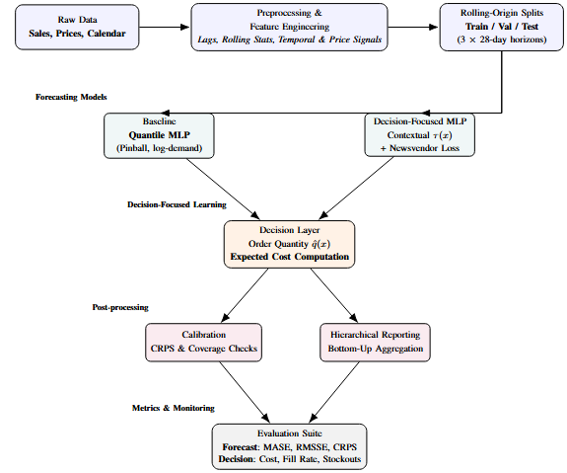
Methodology

Slide 12
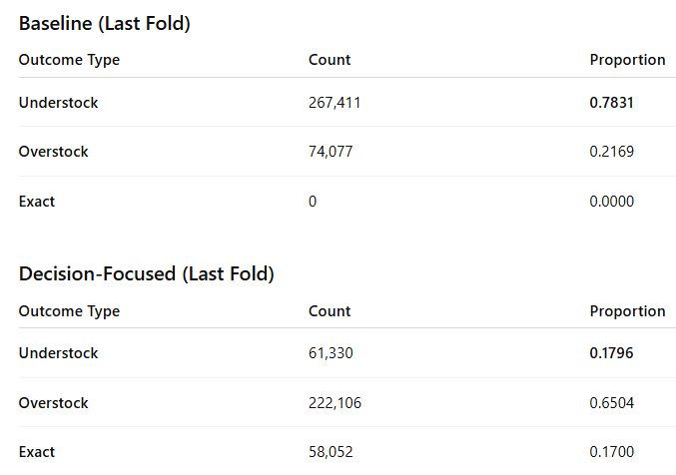
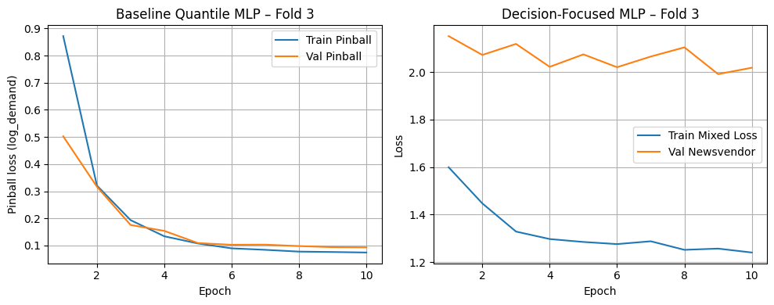
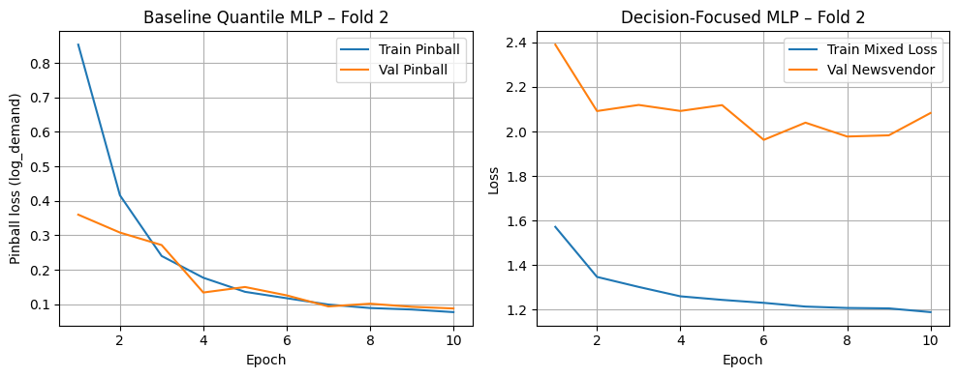
Results
Metric | Baseline | Decision Focused
MASE | 0.6806 | 0.9083
RMSSE | 6.9630 | 0.9327
Expected Cost | 2.9145 | 2.0935
Fill Rate | 0.4896 | 0.7975
Stockout Frequency | 0.5158 | 0.1546
CRPS | 1883.63 | 1.3339
The baseline dramatically under-orders (78% cases).
The DF model reduces understocking to 18% and introduces healthy buffers.
Decision-Focused Learning reduces expected cost by 28% and stockouts by 70%, while improving fill-rate by +62.9%.

Slide 13
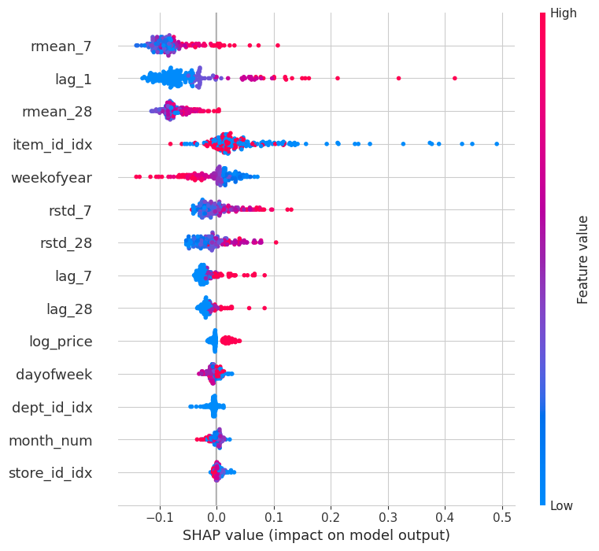
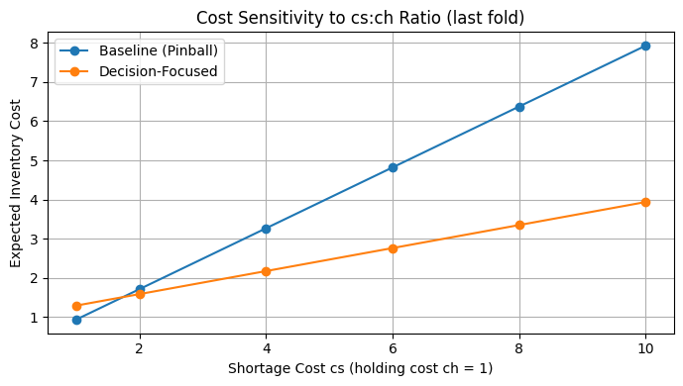
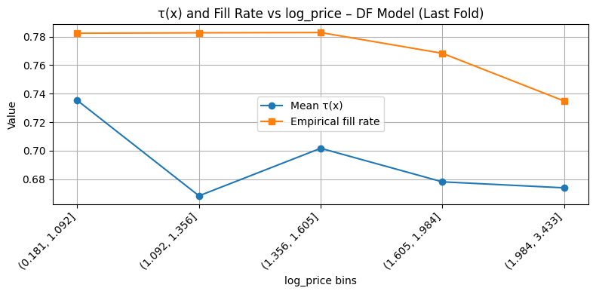
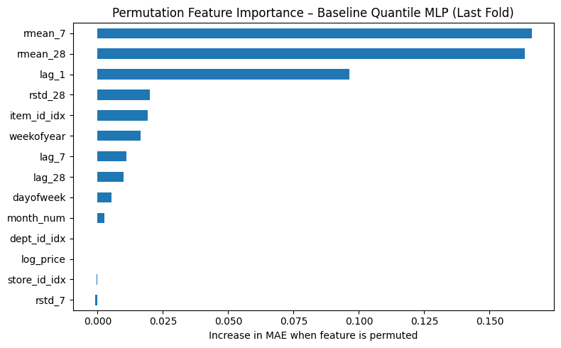
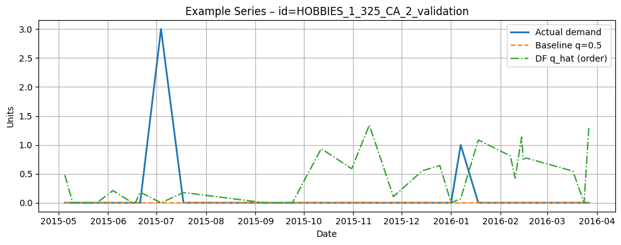
Results

Slide 14
Conclusions
Decision-focused learning aligns forecasting with operational cost, outperforming accuracy-centric approaches in inventory management.
Contextual service levels τ(x) enable adaptive ordering policies that reflect item characteristics, seasonality, and cost asymmetry rather than a fixed global threshold.
Unified evaluation (forecast + decision metrics) demonstrates that models with slightly higher statistical error can still deliver materially superior business outcomes.
Hierarchical reconciliation preserves coherence across organizational levels, enabling tactical item-level decisions while supporting strategic aggregate planning.
The framework is implementation-ready, scalable to thousands of items, and deployable in real retail environments.

Slide 15
Selected References
[1] A. N. Elmachtoub and P. Grigas, “Smart ‘predict, then optimize’,” Management Science, vol. 68, no. 1, pp. 9–26, Jan. 2022.
[2] R. Koenker and G. Bassett, “Regression quantiles,” Econometrica, vol. 46, no. 1, pp. 33–50, Jan. 1978.
[3] T. Gneiting and A. E. Raftery, “Strictly proper scoring rules, prediction, and estimation,” Journal of the American Statistical Association, vol. 102, no. 477, pp. 359–378, 2007.
[4] B. Lim, S. Ö. Arık, N. Loeff, and T. Pfister, “Temporal fusion transformers for interpretable multi-horizon time series forecasting,” International Journal of Forecasting, vol. 37, no. 4, pp. 1748–1764, Oct.–Dec. 2021.
[5] D. Salinas, V. Flunkert, J. Gasthaus, and T. Januschowski, “DeepAR: Probabilistic forecasting with autoregressive recurrent networks,” International Journal of Forecasting, vol. 36, no. 3, pp. 1181–1191, July–Sept. 2020.
[6] S. Makridakis, E. Spiliotis, and V. Assimakopoulos, “The M5 accuracy competition: Results, findings, and conclusions,” International Journal of Forecasting, vol. 38, no. 4, pp. 1346–1364, Oct.–Dec. 2022.
[7] R. J. Hyndman, R. A. Ahmed, G. Athanasopoulos, and H. L. Shang, “Optimal combination forecasts for hierarchical time series,” Computational Statistics & Data Analysis, vol. 97, pp. 15–26, May 2016.

